Slide 1

Inference of population structure and history from genetic data: Structure, TreeMix and beyond
Jonathan K Pritchard
Departments of Genetics & Biology; HHMI
Stanford University
Web: pritchardlab.stanford.edu
H
Congen, Flathead Lake, Sept 2015
Henry Stewart Talks

Slide 2

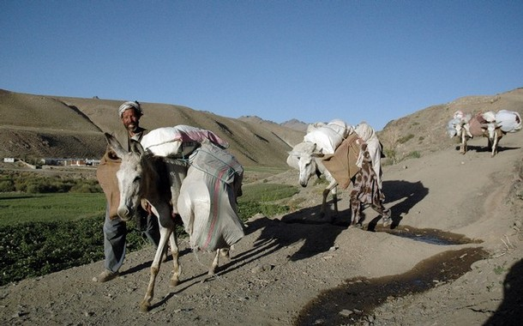
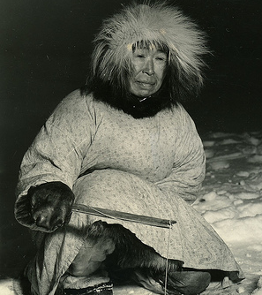
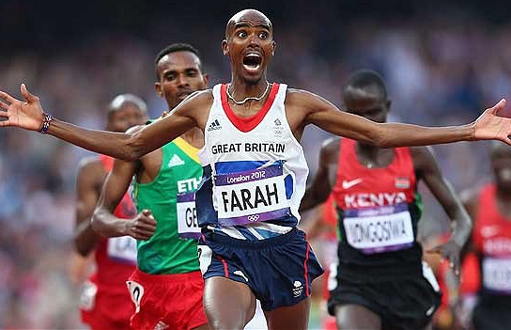





Slide 3
Topics:
overview of Structure and related techniques
Structure AMA
2 minute break
inference of trees with mixture and admixture
a short excursion into (my take on) adaptation

Slide 4
A short list of resources and papers
Download Software and documentation: http://pritchardlab.stanford.edu/structure.html
Additional plotting software: distruct, CLUMPP: see Noah Rosenberg’s website.
Help with organizing the data: Structure Harvester: Dent Earl’s website, UCLA
Inference of population structure using multilocus genotype data. Pritchard, Stephens, Donnelly, 2000. Genetics 155: 945-959. [Basic models]
Inference of population structure using multilocus genotype data: Linked loci and correlated allele frequencies. Falush, Stephens and Pritchard. 2003. Genetics, 164: 1567-1587. [F model, linkage model]
Inference of population structure using multilocus genotype data: dominant markers and null alleles. Falush, Stephens and Pritchard. 2007 Molecular Ecology Notes. [models for AFLPs, etc]
Inferring weak population structure with the assistance of sample group information. Hubisz MJ, Falush D, Stephens M, Pritchard JK. 2009. Molecular Ecology Resources. [more informative priors to increase power in small data sets]
Variational inference of population structure in large SNP datasets. A Raj, M Stephens, and JK Pritchard. 2014. Genetics, 197:573-589. [speeded-up algorithms for large genomic data sets]
ADMIXTURE from Lange group, UCLA. [ML version of Structure: fast analysis of genomic data]
Inference of population splits and mixtures from genome-wide allele frequency data. JK Pickrell and JK Pritchard. PLOS Genetics, 8(11):e1002967, 2012. [TreeMix paper; for detection and interpretation of admixture—see also MixMapper and D statistics from David Reich lab]
In Progress for admixture graphs: DAGMix from Bhaskar, Lawson… Pritchard.

Slide 5
Often useful to classify individuals in a sample into subpopulations.
Subjective approaches based on:
  geographic location
  linguistic, cultural or physical characters
Difficult to know whether such criteria lead to natural assignments in genetic terms.

Slide 6
In the late 90s a number of groups showed that multilocus genetic data provides powerful information about population relationships and history

Slide 7
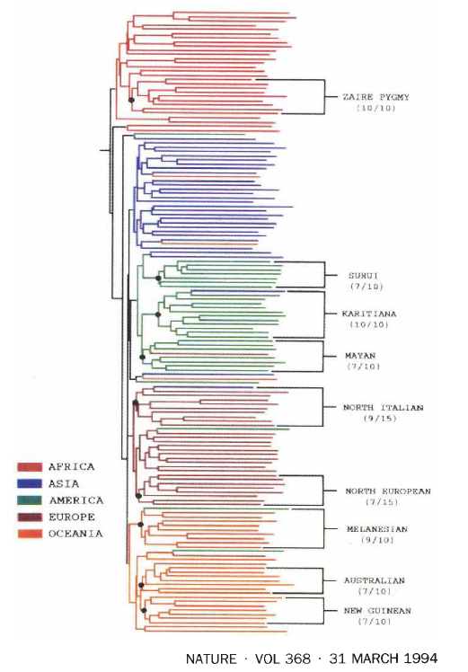
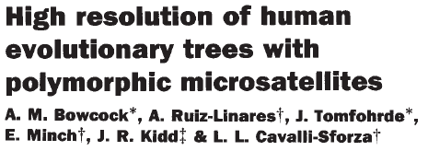

Genetic variation reflects population history and structure
27 autosomal STRs used for clustering

Slide 8
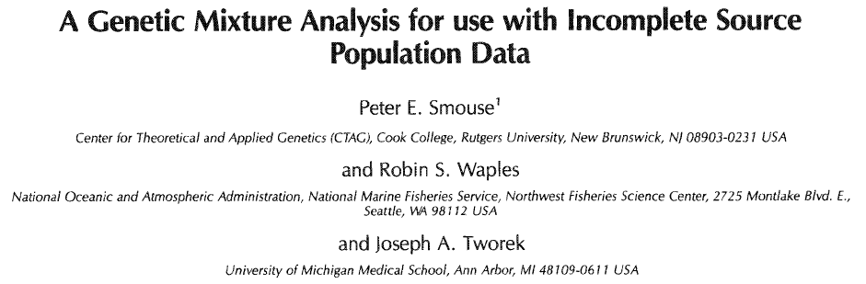
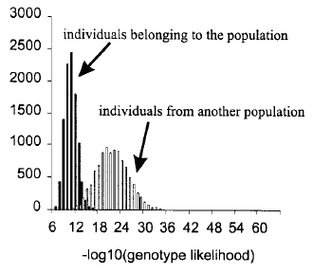
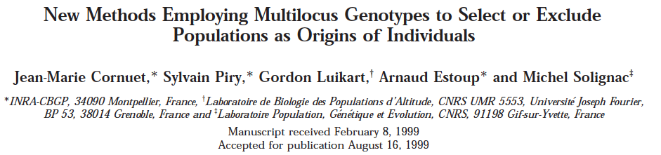
Early work on mixture models and assignment tests

Slide 9


In 1998 we set out to use these insights to cluster individuals into genetic populations de novo
Matthew Stephens
Peter Donnelly

Slide 10
Structure uses multi-locus genotype data to infer population structure

Slide 11
Typical data:
Individual Locus 1 Locus 2 Locus 3 Locus 4
1 A,A A,A A,C A,A
2 A,B A,A A,B A,A
3 B,B A,B A,A A,A
4 C,C D,E D,E B,C
5 C,C C,D D,D B,D
6 B,C E,E A,E C,E
7 A,C D,D C,D A,D
{A,B,C,D,E} are labels for the different alleles at each locus.
These genotypes might suggest that individuals 1,2,3 draw their alleles from a different gene pool than do individuals 4,5,6,7, suggesting the presence of 2 distinct populations.

Slide 12
A simple model of population structure
  Individuals in our sample represent a mixture of K (unknown) populations.
  Each population is characterized by (unknown) allele frequencies at each locus.
  Within populations, markers are in Hardy-Weinberg (HWE) and linkage equilibrium (LE).
Roughly speaking, we aim to sort individuals into K clusters so as to minimize departures from HWE and LE.

Slide 13
More on the model...
Let P₁, P₂, …, P_{K} represent the (unknown) allele frequencies in each subpopulation
Let Z₁, Z₂, … , Z_{m} represent the (unknown) subpopulation of origin of the sampled individuals
Assuming Hardy-Weinberg and linkage equilibrium within subpopulations, the likelihood of an individual’s genotype in subpopulation k is given by the product of the relevant allele frequencies:
x₂
Pr(G_{i} | Z_{i}= k, P_{k}) = Π p^{(k)} p^{(k)}
x₁
loci

Slide 14
Then, using Bayes’ rule, we can write down the probability that individual i is from subpopulation k:
Pr(G_{i} | P_{k}, Z_{i}= k) Pr(Z_{i}= k)
Σ Pr(G_{i} | P_{j}, Z_{i}= j) Pr(Z_{i}= j)
j=pops
Here, Pr(Z_{i}= k) gives the “prior” probability that individual i is from subpopulation k. [We ordinarily set this prior to 1/K, in which case the assignment probabilities are simply proportional to the likelihoods.]

Slide 15
Similarly, a natural estimate of the allele frequencies in subpopulation k is:
Freq of allele j at locus l in pop k
=
# copies of allele j in individuals from k
2 (# individuals from subpopulation k)
[It is convenient to use a Dirichlet prior for P, in which
case the posterior is roughly centered around this
point estimate]

Slide 16
If we knew the population allele frequencies in advance, then it would be easy to assign individuals.
If we knew the individual assignments, it would be easy to estimate frequencies.
In practice, we don’t know either of these, but the following MCMC algorithm converges to sensible joint estimates of both.

Slide 17
MCMC algorithm (for fixed K)
Start with random assignment of individuals to populations
Step 1: Gene frequencies in each population are estimated based on the individuals that are assigned to it.
Step 2: Individuals are assigned to populations based on gene frequencies in each population.
And this is repeated...
…Estimation of K performed separately.

Slide 18
The two basic ancestry models used by structure.
  No Admixture: each individual is derived completely from a single subpopulation
  Admixture: individuals may have mixed ancestry: some fraction q_{k} of the genome of individual i is derived from subpopulation k.
  The admixture model allows for hybrids; in addition it is more flexible and often provides a better fit for complicated structure, and we use it as the default.

Slide 19

Example: Taita Thrush data*
  three main sampling locations in Kenya
  low migration rates (radio-tagging study)
  155 individuals, genotyped at 7 microsatellite loci
*Data from Peter Galbusera et al (2000)

Slide 20
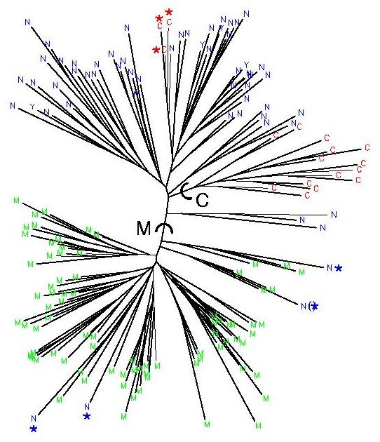
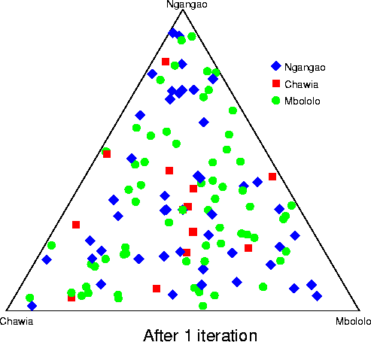
Neighbor-joining tree of the thrush data

Slide 21
  Can we use Structure to infer the sampling locations of birds from the genetic data?

Slide 22
Estimation of structure for the Taita thrushes. Each dot is one individual, labeled according to sample location. Position in the triangle indicates fraction of membership in each of 3 clusters (points in the corners are completely assigned to one cluster).

Slide 23
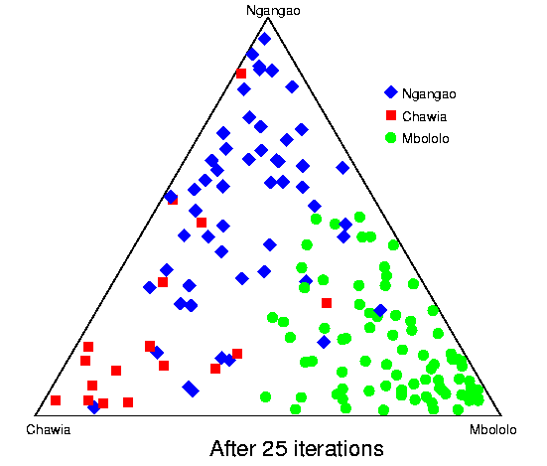

Slide 24
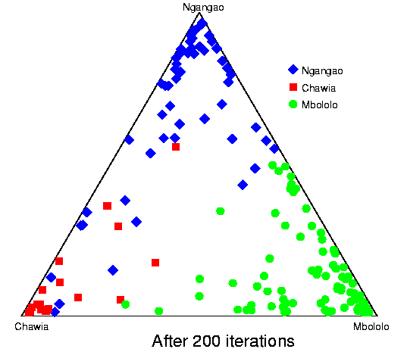

Slide 25
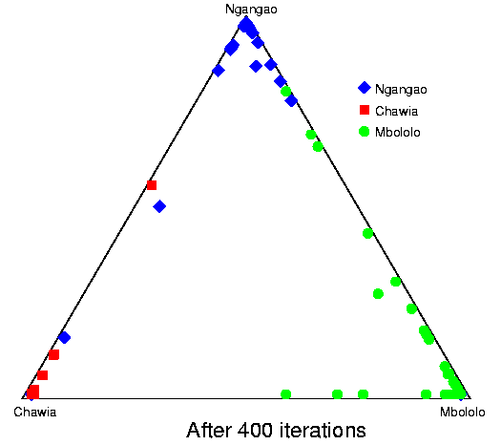

Slide 26
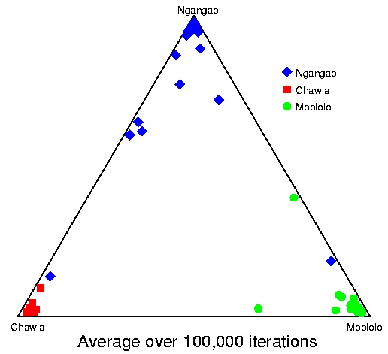
For these data—despite having only 7 markers—Structure identifies 3 clear clusters that correspond well with the known geographic labels.
Is there evidence for migration?
Is K=3 the best model?

Slide 27
Estimating K
  Structure is run separately at different values of K. The program computes a statistic that measures the fit of each value of K (sort of a penalized likelihood); this can be used to help select K.
Assumed value of K
Posterior probability of K
12345
~0 ~0 0.993 0.007 0.00005
Taita thrush data

Slide 28
More on estimating K
In practical applications, estimating K is challenging for at least two important reasons [see the structure manual for further discussion]:
  It is technically difficult to compute the quantity required for model choice, Pr(Data | K, model), and our approximation implemented in structure may not always give the correct ordering.
  More fundamentally, the structure model is obviously a cartoon of reality, and even if we had perfect knowledge, there may be no value of K that would be clearly “correct”. [E.g., K may not be well-defined if there is spatial population structure, or variable levels of relatedness among individuals, and depends on sampling design.]
Structure is often useful as a tool for visualizing population structure, and it may make most to consider results for a range of values of K.
[Note that Evanno et al (2005) suggested a different criterion for estimating K.]

Slide 29
Models with informative priors

Slide 30
Informative priors 1: detecting migrants (for very informative data)
Are any of the thrushes migrants, or descended from recent migrants?
Having shown that the unguided structure output corresponds closely to the population labels, we will now change the model to assume that the population labels are USUALLY CORRECT.
We test whether there is evidence that particular individuals are migrants or recent hybrids.

Slide 31
[Some details about the migration model…]
In order to detect migrants, we assume that individuals come from a pre-assigned population with high probability (e.g. 0.9 or 0.95).
But with smaller probability (e.g. 0.1 or 0.05) they instead have migrant ancestors between 0 and G generations ago.
We assume a constant average rate of migration.
When G=2 then the ratio of migrants is:
1/7 (individual is a migrant and has 100% imported ancestry)
2/7 (individual has migrant parent and has 50% imported ancestry)
4/7 (individual has migrant grandparent and has 25% imported ancestry).
And we assume any migrant ancestry from earlier generations will not be detectable.

Slide 32
Are any of the thrushes migrants?
Individual
Immigrant
Geographic origin
Possible source
No immigrant ancestry
Immigrant parent
Immigrant grandparent
1
Ngangao
Chawia
0.008
0.052
0.063
0.05
0.869
0.019
0.106
0.123
0.739
2
Ngangao
Mbololo
0.10
0.029
0.126
0.168
0.05
0.673
0.046
0.203
0.273
0.10
0.472
3
Mbololo
Ngangao
0.002
0.179
0.165
0.649
0.05
0.003
0.271
0.253
0.464
4
Mbololo
Chawia
0.10
0.000
0.007
0.082
0.891
0.05
0.000
0.014
0.157
0.791
0.10
Total probability that this individual has no migrant ancestry.
Prior probability v that an individual is a migrant.
3
1
2
4

Slide 33
Comments on the migration example.
  There is not compelling evidence that any of the Taita birds are migrants or hybrids. It would take more data to resolve this question.
  The migration model is fundamentally different from the basic structure models because it assumes that the prior population information is probably correct. It takes strong data contradicting this to overcome the prior population information.

Slide 34
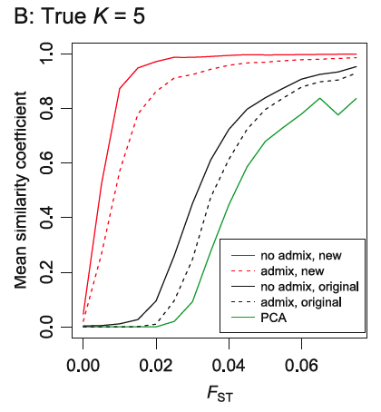
2. Informative priors for weak data (Hubisz et al 2009)
  At the other end of the spectrum, there are cases where population structure is real, but too weak for Structure to detect using the standard models.
  For this setting, we now provide an option that allows the user to define “sampling locations”. Structure can then apply a prior in which individuals from the sampling location tend to cluster together, if the data support this.

Slide 35
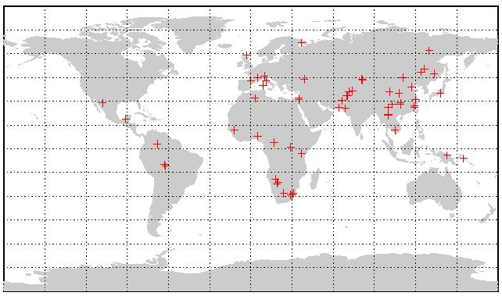
structure as a descriptive tool
  Study of 52 human populations, 1056 individuals
  What is the worldwide distribution of genetic variation?
Rosenberg et al 2002, etc

Slide 36


Inferred population structure
Africans Europeans MidEast Cent/S Asia Asia Oceania America
Each individual is a thin vertical line that is partitioned into K colored segments according to its membership coefficients in K clusters.

Slide 37
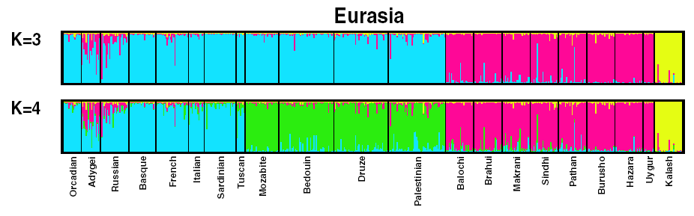
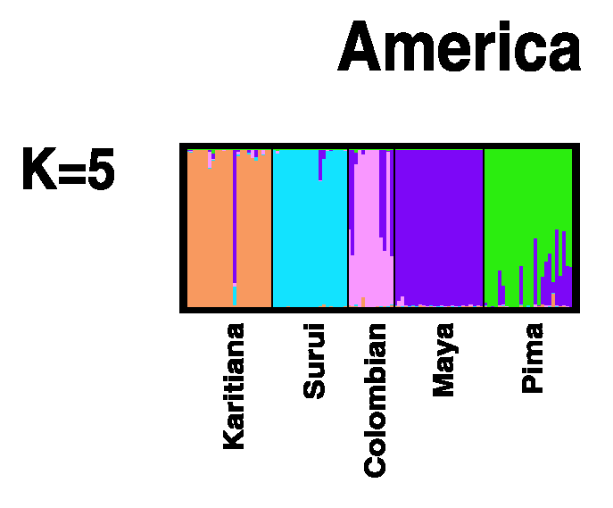
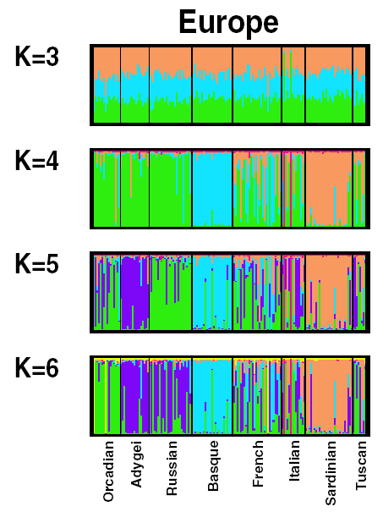
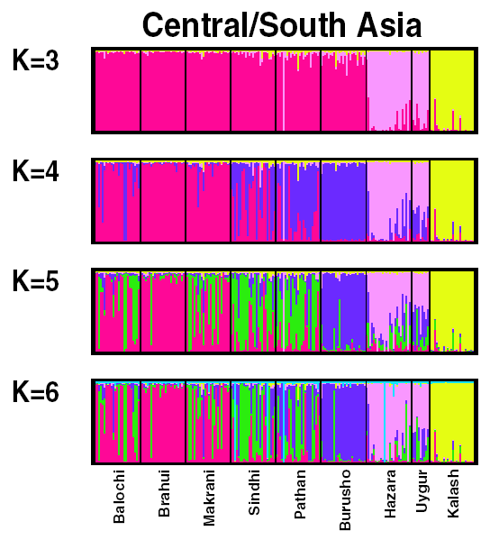
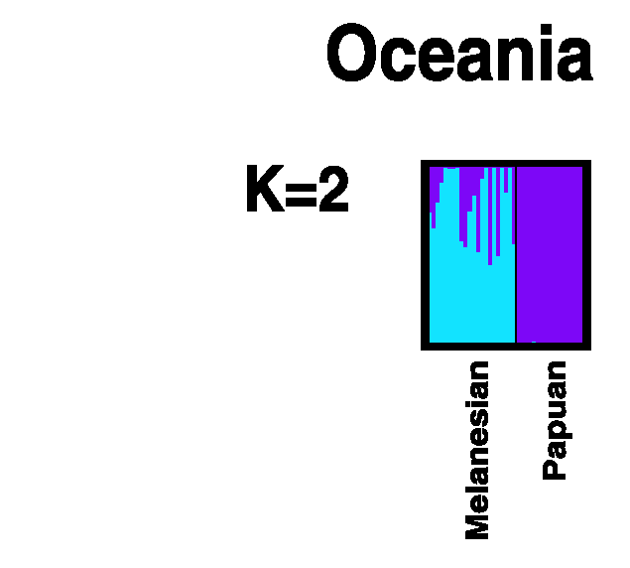
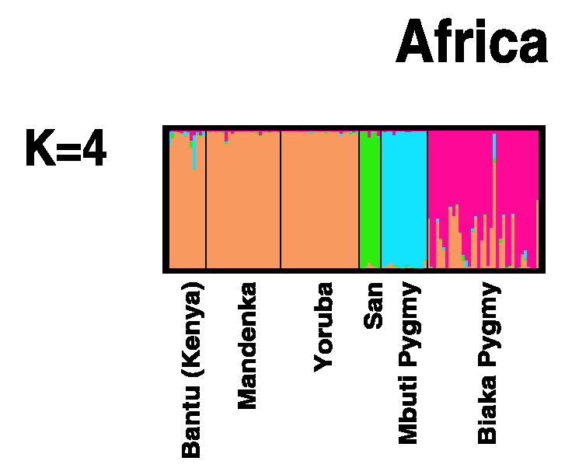
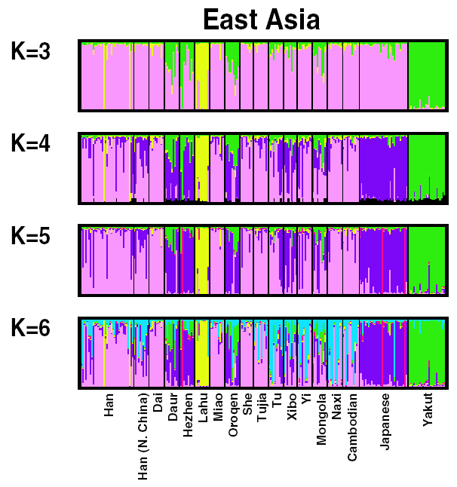
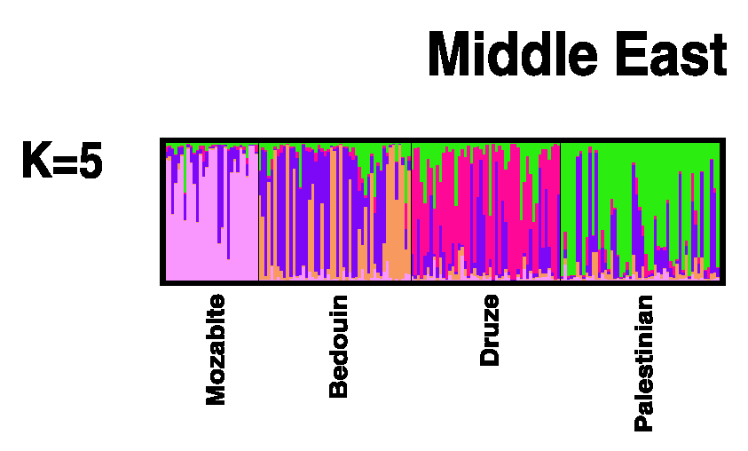
Inferred population structure – regions

Slide 38
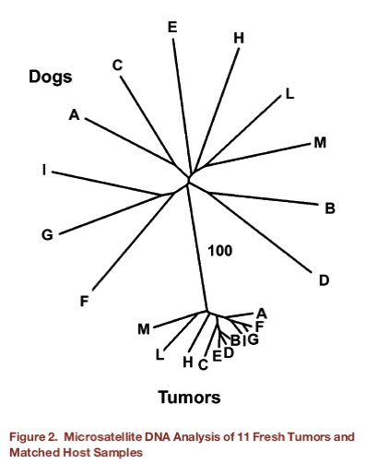
structure as a tool for identifying source populations
  Murgia et al (2006) studied an odd infectious, sexually transmitted tumor of dogs (CTVT= canine venereal transmissible tumor). CTVT has a worldwide distribution.
  They showed that the infectious agent is actually composed of canine cells. Preliminary data suggested that these are clonal (ie come from a single origin)

Slide 39
Murgia et al then collected data for 73 microsatellite loci for 3 CTVT samples, and 18 loci for 24 additional CTVT samples. These loci had been previously genotyped in ~438 dogs representing a wide range of breeds and 8 wolves.
Questions:
  Do the microsatellite data support the hypothesis that CTVT comes from a single source?
  In what breed or geographic location is the origin of CTVT?
  If there is a single origin, how old is CTVT?

Slide 40
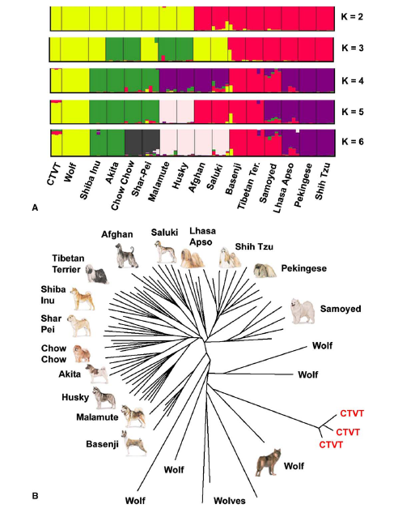
A structure plot and neighbor-joining tree both show that CTVT is closest to wolves among the available canid samples.

Slide 41
Genome-wide data
ADMIXTURE and fastStructure for better speed with basic algorithm
fineSTRUCTURE (Lawson et al) for higher resolution (requires high resolution data with good genome)

Slide 42
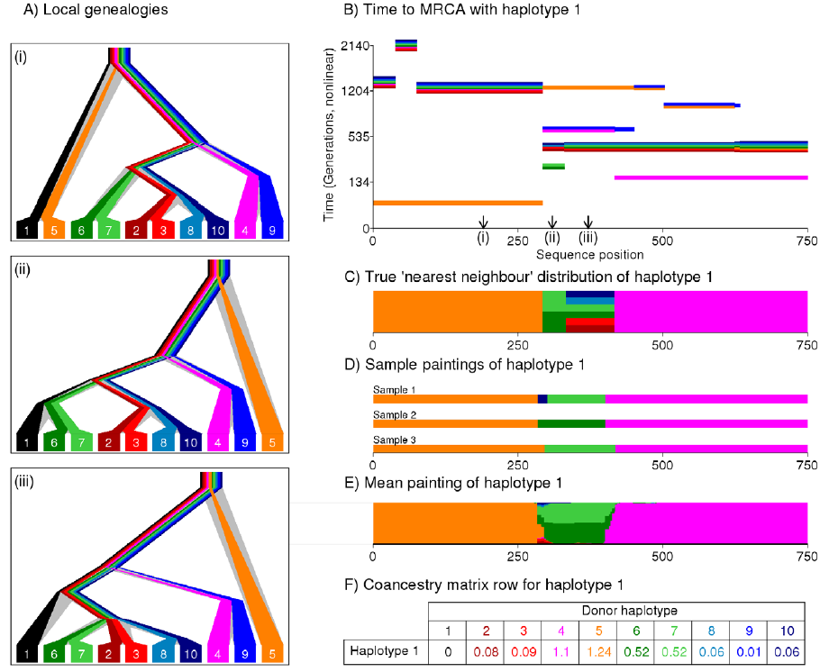
fineSTRUCTURE – Lawson (2012)
[Est number of chunks]

Slide 43
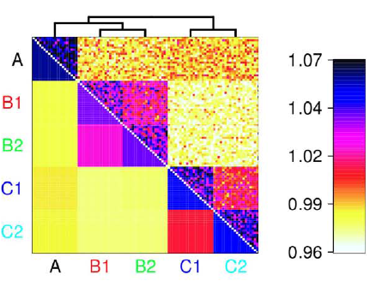
Matrix of copying rates reflects ancestral groups (simulation)

Slide 44
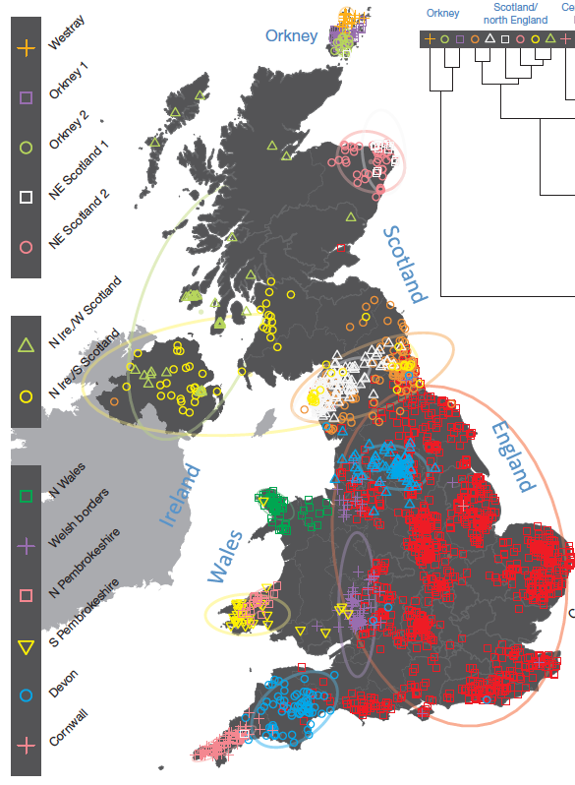
Leslie et al (2015): fineSTRUCTURE enables super-high resolution clustering, even with the British isles.
(2000 “carefully chosen”
GB+NI individuals; 500K SNPs)

Slide 46

So far we have talked about learning current structure.
How are modern populations historically related?
Work with Joe Pickrell

Slide 47
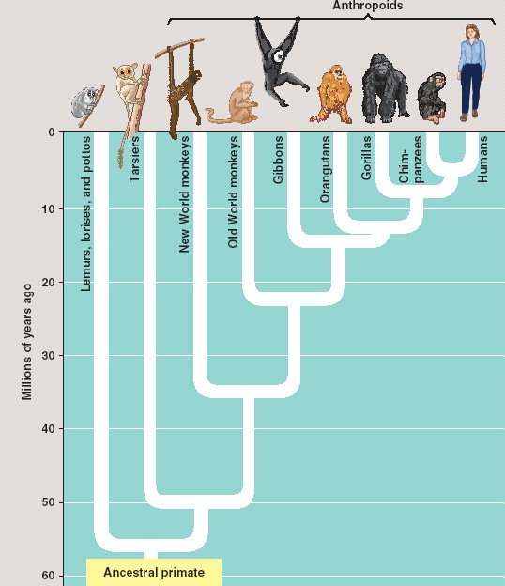
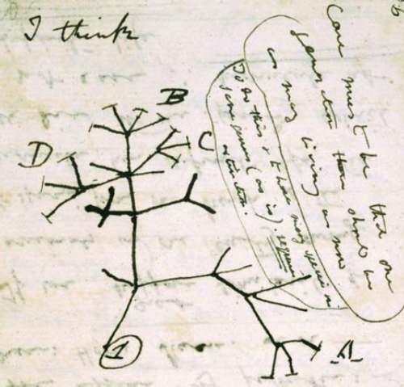
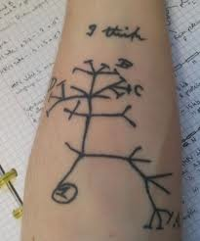
Phylogenetic trees are central to how we think about evolutionary relationships…
from Darwin’s notebook (1838)
phylogeny of the primates

Slide 48
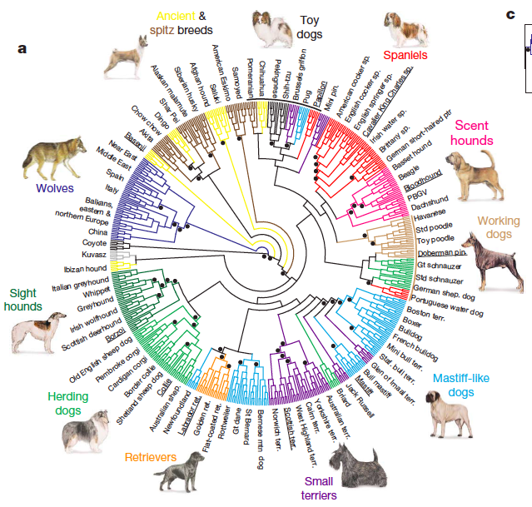
Trees are also widely used for visualizing the relationships among populations of a species
Tree of dog breeds from vonHoldt et al 2010

Slide 49
But if there has been ancient migration or admixture, then a bifurcating tree may not be a good description of population histories
*See also key work in this area by David Reich and colleagues

Slide 50
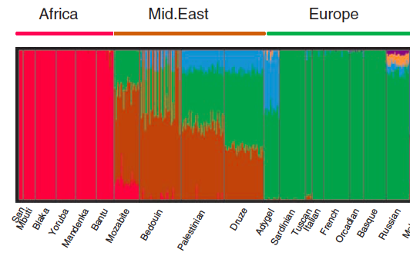
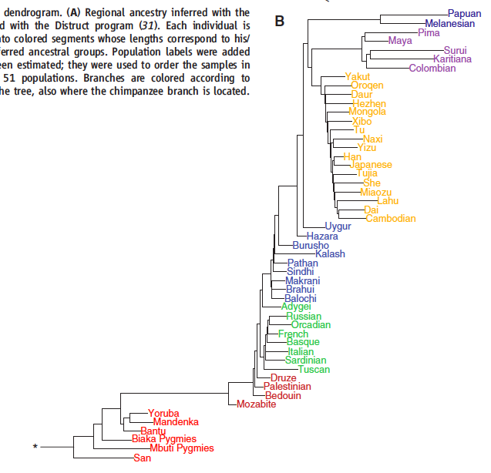
For example, many human populations show evidence for historical admixture
“Structure” plot: individual membership in genetic clusters
Europe
Mid.east
Africans
Plots from Li et al (2008); data are 650k SNPs for HGDP

Slide 51
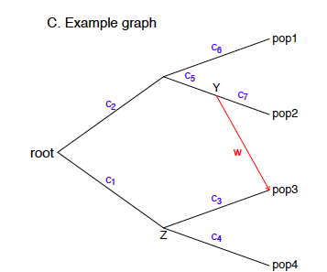
In some cases a graph might describe history better than a bifurcating tree
A graph could allow both population splits and mixture events

Slide 52
How do we estimate historical graphs?
Assume that we have SNP data for hundreds of thousands of SNPs in each of a series of populations

Slide 53
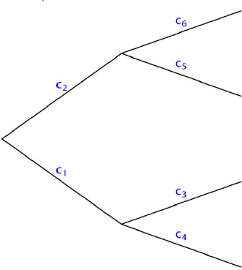
To estimate trees without migration we assume that allele frequencies drift along each branch by Brownian motion
X₁
X₂
X₃
X₄
This model leads to a simple covariance matrix which can be used to estimate the tree
*this type of model was first developed by Felsenstein & Cavalli-Sforza back in the 1970s

Slide 54
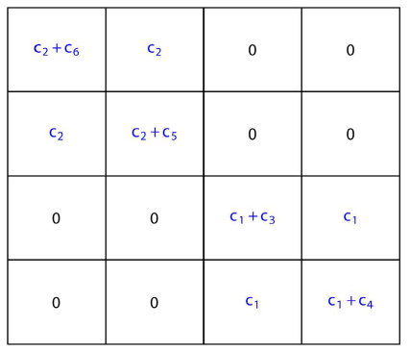
To estimate trees without migration we assume that allele frequencies drift along each branch by Brownian motion
X₁
X₁
X₂
X₂
X₃
X₃
X₄
X₄
X₁
X₂
X₃
X₄
This model leads to a simple covariance matrix which can be used to estimate the tree
*this type of model was first developed by Felsenstein & Cavalli-Sforza back in the 1970s

Slide 55
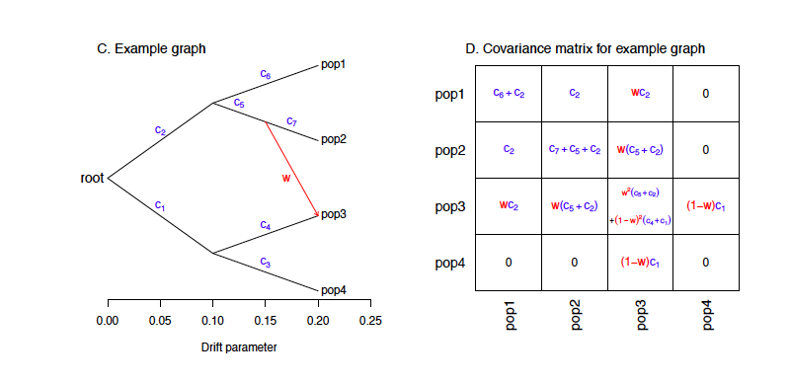
Migration events create extra covariance between populations that cannot be explained by a single tree model
X₁
X₂
X₃
X₄

Slide 56
Migration events create extra covariance between populations that cannot be explained by a single tree model
X₁
X₁
X₂
X₂
X₃
X₃
X₄
X₄
X₁
X₂
X₃
X₄
We can now tackle the inverse problem of going from a covariance matrix to a migration graph.

Slide 57
Now for some examples….

Slide 58
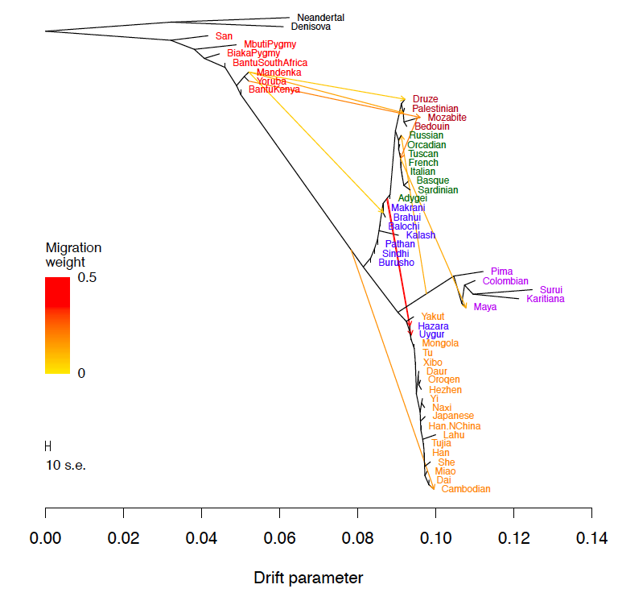
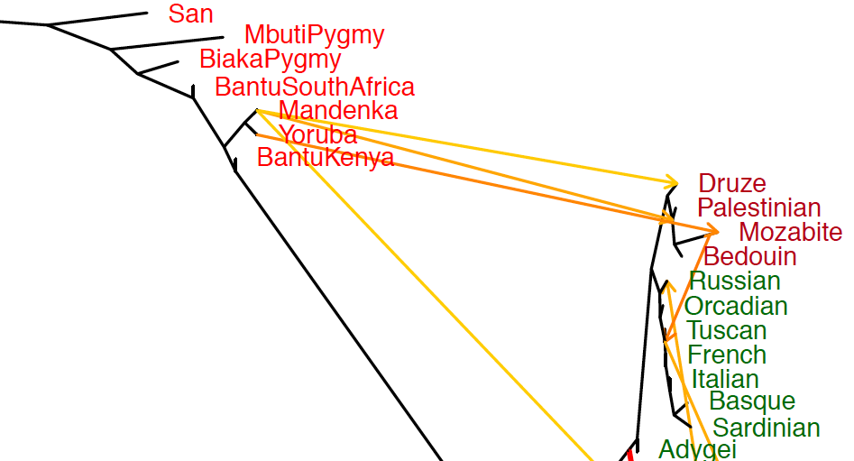
An estimated graph of human population relationships

Slide 59
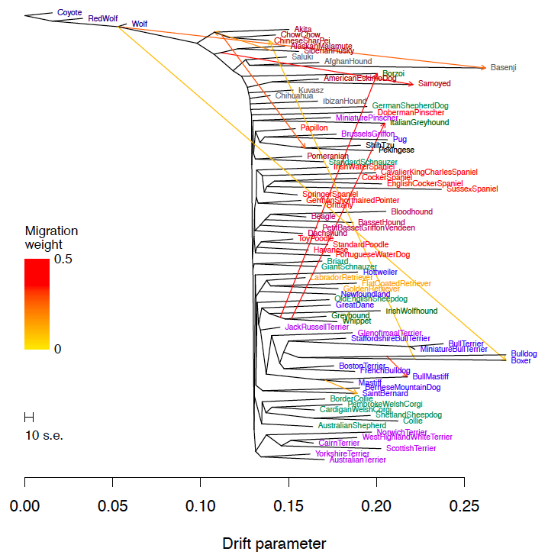
The graph of dog breed relationships

Slide 60
Borzoi
Sighthounds are scattered across the tree
Italian greyhound
Wolfhound, greyhound, whippet

Slide 61
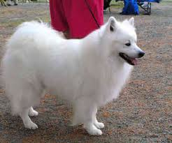
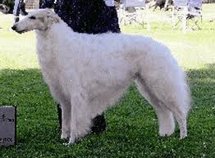
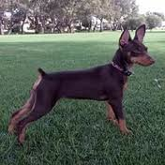
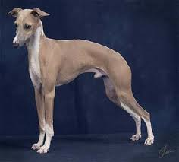
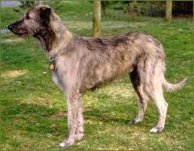
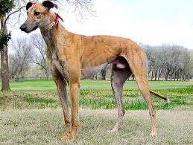
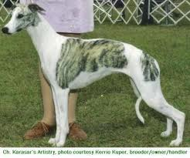
Borzoi
Eskimo dog
Samoyed
Eskimo dog
Borzoi
Italian greyhound (6kg)
Miniature pinscher (4kg)
Irish wolfhound (50kg)
Mini pinscher
Italian greyhound
Greyhound (35kg)
Whippet (10kg)
wolfhound
greyhound
whippet

Slide 62
What sort of signal would selection produce in this model?

Slide 63

Selection might cause unusual allele frequency distributions at particular SNPs: e.g., sharing of alleles between distantly related populations that share a selection pressure
So we can ask for each SNP how well the allele frequencies fit the global covariance model.
Joe Pickrell + Graham Coop

Slide 64
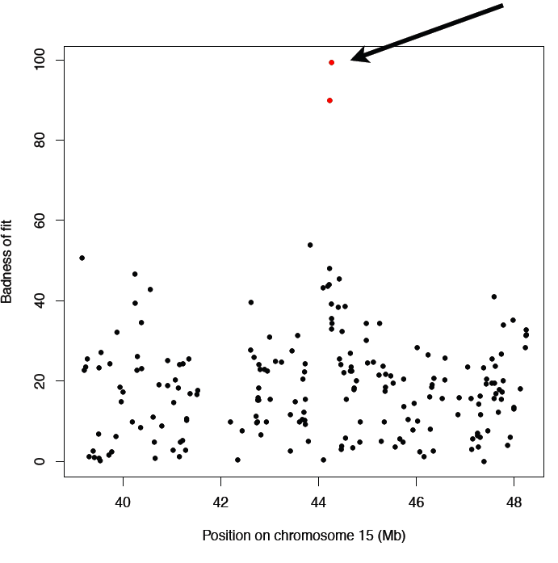

Dog data: eg two SNPs on Chr 15 that diverge strongly from overall patterns
Joe Pickrell

Slide 65

The outlier SNPs on Chr15 are adjacent to IGF1
Joe Pickrell

Slide 66
*Association data from Boyko et al (2010); analysis by Joe Pickrell (2012)
Indeed ALL of the top outlying regions in dogs are associated with morphological phenotypes that may have been targeted by breeders:
Chrom Nearest gene Phenotype*
10 MSRB3 body size
15 IGF1 body size
24 ASIP coat color
10 MSRB3 body size
20 MITF coat color
13 RSPO2 coat length/texture
1 CDC37L1/AK1 snout length

Slide 67
*Lamason (2005),
**Sabeti (2007)
But in humans the picture is less clear as only two of the top hits are currently associated with a known selected phenotype
Chrom Nearest gene Phenotype
15 SLC24A5 *skin pigmentation
2 EDAR **hair morphology/sweat glands
10 CYP26A1/FER1L3 ?
2 KIF3C ?
16 LONP2 ?
2 CNTNAP5 ?
3 FOXP1 ?

Slide 68


Coop et al (2009), PLoS Genetics
Moreover, in humans, even the most discordant SNPs are strongly influenced by neutral population structure…
Global distribution of allele associated with lighter skin at SLC24A5 (in red)
Neutral population structure (clusters from Structure)

Slide 69
Various lines of evidence are starting to suggest that really strong selection at individual loci is rare in humans and that most adaptation may proceed by small changes at many loci (ie polygenic adaptation)
[see especially pioneering work from Graham and others in this area]

Slide 70

We have proposed that most human adaptation occurs by a polygenic mechanism that is much more difficult to detect
Pritchard et al (2010), Curr Biol

Slide 71
To understand polygenic adaptation, we will have to get much better at incorporating external information on which variants are most likely to be functional

Slide 72

Most traits in humans are driven by small effects spread across hundreds or thousands of loci.
Eg: A study of 253,000 people identified 697 different loci that affect human height by about 3mm each (Wood et al, Nature Genetics, 2014)
Figure from Weedon et al 08

Slide 73
Northern Europeans are taller than southern Europeans and other human populations

Slide 74

Comparing GWAS data with allele frequency differences suggests that this is adaptive (not environmental)
Turchin et al 2012

